Slide 1
CMSIS-RTOS2

Slide 2
Content of this Module
We cover the following topics in this module
Why RTOS
Compare with Super loop
CMSIS-RTOS2
CMSIS
Notes:
inputs and environment conditions.

Slide 3
Real-Time Operating Systems
Real-time operating systems (RTOS) are designed to meet harsh timing constraints
Hard real-time – critical Threads which have to be completed on time
Soft real-time – may continue finishing the Thread even missing the deadline
Industrial applications: robots, aircraft control …
Key design requirements:
Predictability and determinism
Speed – fast enough while keeping high predictability and determinism
Responsive to user control
Fail-safety
Advanced scheduling and memory allocation
Notes:
Real-time operating systems make sure that the Threads meet the timing requirements, i.e. finish execution before the dead line. The Thread can be hard real time – where the Threads need to finish before the deadline always. Example is an engine fuel to air ratio control is a hard real time Thread. The Thread can be a soft real time where the Thread may miss the deadline once in a while. Example is an automotive speed display on the dashboard. Examples can be found in robots, aircraft control etc. The real time system design requirements are determinism, speed to meet the deadlines, accuracy, fail safe operation, respond to various inputs and environment conditions.

Slide 4
Why RTOS on embedded systems?
Although it is possible to implement everything in a huge sequential loop…
Uses lengthy interrupt service routine (ISR)
Needs to keep synchronization between ISRs
Poor predictability (nested ISRs) and extensibility
Change of the ISR or the Super-Loop ripple through the entire system
RTOS: all computation requests are encapsulated into Threads and scheduled on demand
Better program flow and event response
MultiThreading
Concise ISRs thus deterministic
Better communication
Better resource management
Easier to develop applications
Notes:
One can assign one interrupt for each Thread and whenever there is an interrupt, execute the Thread with the interrupt service routine (ISR). The interrupt can be generated at periodic intervals or due to an external or internal condition.
If the system has too many interrupts, then predictably, problems can occur due to nested interrupt etc. may appear.
RTOS eliminates the above problem and provides a better program flow, better event response, provides good multiThreading, predictable Thread scheduling, meet the dead lines of all the Threads and many more advantages.

Slide 5
A case in point
GPS based Speed Camera Alarm and Moving Map
Sounds alarm when approaching a speed camera
Display’s vehicle position on LCD
Also logs driver’s position information
Hardware: GPS, user switches, speaker, LCD, flash memory
Threads:
Dec: Decode GPS sentence to find current vehicle position.
Check: Check to see if approaching any speed camera locations. Takes longer as the number of cameras increases.
Rec: Record position to flash memory. Takes a long time if erasing a block.
Sw: Read user input switches.
LCD: Update LCD with map.
How to implement in a super loop?
Run Threads in the same order every time?
Allow preemption?
Dec
Check
Rec
Sw
LCD
Time
Notes:
Example: An example real-time system is a speed camera alarm system which uses GPS information of the current location of the vehicle which is moving at a high speed and a map with camera locations around the current location of the vehicle.
The Threads for achieving this are:
Decode the GPS information to find the current location of the vehicle
Check the locations of the camera around the current vehicle location
Record: Log driver’s position in the flash
Read user’s input settings or switches
Sound an alarm if the vehicle is approaching a speed camera
All the above Threads can be in a super-loop in the same order or with interrupt service routine.

Slide 6
Super-loop
Dec
Check
Rec
Sw
LCD
Dec
Simple but…
Always run the same schedule, regardless of changing conditions and relative importance of Threads.
All Threads run at the same rate. Changing rates requires adding extra calls to the function.
Maximum delay is the sum of all Thread run times. Polling/execution rate is equal to 1/maximum delay.
What if we receive GPS position right after Rec starts running?
Delays
Have to wait for Rec, Sw, LCD before we start decoding position with Dec.
Have to wait for Rec, Sw, LCD, Dec, Check before we know if we are approaching a speed camera!
while (1){
Dec();
Check();
Rec();
Sw();
LCD();
}
Notes:
A super-loop may execute each Thread in the same order and it can not respond to changing conditions in the input, recording time etc.

Slide 7
RTX5
Royalty-free, deterministic, open source RTOS
High-Speed real-time operation with low interrupt latency
Flexible Scheduling: round-robin, pre-emptive, and collaborative
Small footprint for resource constrained systems
Compatible with Arm cores (from Arm7, Arm9 to Cortex-M processors) and software tools (Keil MDK-Arm)
Support for multithreading and thread-safe operation
Kernel aware debug support in Keil MDK-Arm
Dialog-based setup using µVision Configuration Wizard
Notes:
CMSIS-RTOS2 is a real time operating system from Keil. The Keil RTX5 is a royalty-free, deterministic real-time operating system designed for Arm and Cortex-M devices. It allows you to create programs that simultaneously perform multiple functions and helps to create applications which are better structured and more easily maintained.

Slide 8
FreeRTOS
Royalty-free, deterministic, open source RTOS
High-Speed real-time operation with low interrupt latency
Flexible: round-robin, pre-emptive, and collaborative
Scalable from tiny MCUs to multi-core device
Compatible with Arm cores (from Arm7, Arm9 to Cortex-M processors) and software tools (Keil MDK-Arm)
Support for multithreading and thread-safe operation
Works across many toolchains: GCC, IAR, Keil
Rich community and documentation

Slide 9
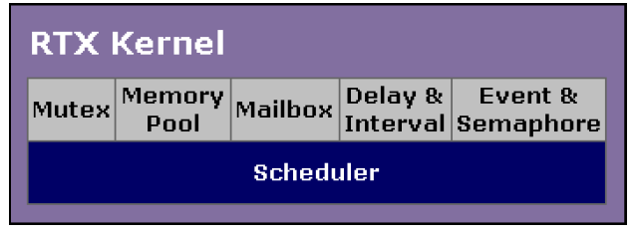
RTX5 Structure
RTX5 Kernel (CMSIS-RTOS2)
Core real-time scheduler
Supports Threads, mutexes, semaphores, event flags, delay & timer functions, memory pools and message queues
CMSIS Middleware(optional via Packs)
Add-on libraries include:
File System
Networking
USB Device/Host
CAN Interface
Notes:
The Keil real-time library is on top of the RTX kernel and contains libraries for flash file system, TCP/IP, CAN interface, USB interface etc.
The RTX kernel helps in scheduling Threads. It supports mutex, memory pool, mailbox, timing functions and event/semaphores.

Slide 10
FreeRTOS Structure
FreeRTOS Kernel (CMSIS-RTOS2)
Lightweight, portable, open source RTOS
Supports Threads, mutexes, semaphores, event flags, delay & timer functions, memory pools and message queues
CMSIS Middleware(optional via Packs)
Add-on libraries include:
File System
Networking
USB Device/Host
CAN Interface

Slide 11
RTX5 Files
Add CMSIS-RTOS2 via CMSIS-Pack
Select CMSIS::RTOS2:Keil RTX5 in Keil µVision or STM32CubeIDE
Core configuration files:
rtx_config.h: Configures the kernel via preprocessor defines
cmsis_os2.c: Provides CMSIS-RTOS2 API stubs (may be auto-generated)
Core header:
cmsis_os2.h: The standard RTOS API interface for CMSIS-RTOS v2
Notes:
RTX can be included in the project created using Keil MDK-Arm development environment.

Slide 12
FreeRTOS Files
Add CMSIS-RTOS2 via CMSIS-Pack
Select CMSIS::RTOS2:Keil FreeRTOS in Keil µVision or STM32CubeIDE
Core configuration files:
FreeRTOSConfig.h – Central config (preemption, priorities, hooks, etc.)
FreeRTOS.h – Core API Header
Task.c – Thread scheduler implementation
queue.c – Message queues
semphr.c – Semaphores and mutexes
timers.c – Software timer service
Notes:
RTX can be included in the project created using Keil MDK-Arm development environment.

Slide 13
CMSIS and CMSIS-RTOS2
Arm Cortex Microcontroller Software Interface Standard (CMSIS)
Vendor-independent hardware abstraction layer
Used for Cortex-M processor series
Specifies debugger interfaces
The CMSIS-RTOS2
Standardized RTOS API for Cortex-M systems
Enables RTOS portability across kernels (e.g. RTX5, FreeRTOS)
Notes:
Arm Cortex Microcontroller Software Interface Standard (CMSIS) provides board independent hardware abstraction layer. The supported boards are Cortex M processor boards.
The CMSIS-RTOS API– provides generic RTOS interfaces.

Slide 14
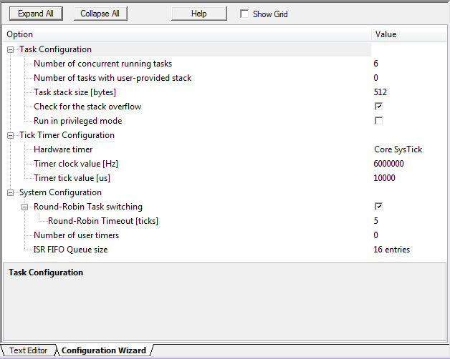
RTX_Conf_CM.c
“<h> <o> <i> <q>” are the annotations for Keil configuration wizard
Configuration wizard provides an easy-to-use GUI (see picture on the right)
Can also change the configuration by directly modifying the file
More about the Keil configuration wizard: http://www.keil.com/support/man/docs/uv4/uv4_ut_configwizard.htm
Notes:
RTX_Conf_CM.C is a configuration wizard with an easy to use graphical user interface as shown in the slide.

Slide 15
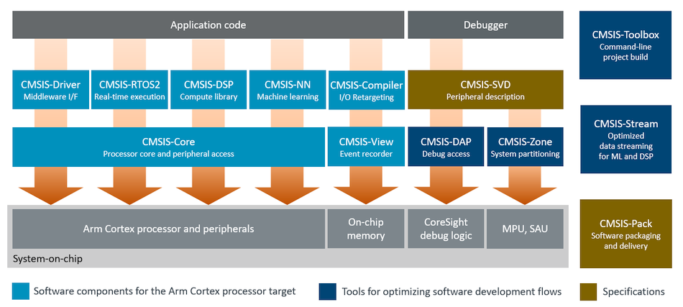
CMSIS and CMSIS-RTOS2
Notes:
A pictorial representation of CMSIS and CMSIS-RTOS on the Cortex M CPU is shown in the slide.

Slide 16
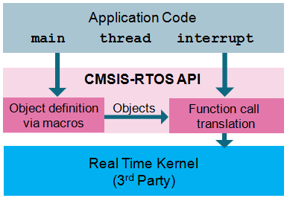
CMSIS-RTOS2 and RTOS Kernel Backends
CMSIS-RTOS2 API – a standardized abstraction layer that supports multiple RTOS kernels (e.g. Keil RTX5, FreeRTOS)
Application programs using CMSIS-RTOS2 can be ported across supported RTOS kernels
In this course, we will focus on using the RTX5/FreeRTOS kernel directly. The CMSIS-RTOS2 API provides the same core concepts but abstracts the kernel interface.
RTX or other 3rd RTOS kernel
Notes:
CMSIS-RTOS API is an abstracted layer on top of RTX kernel or other 3rd party RTOS kernels
Application programs can be easily ported to other 3rd party RTOS kernels (such as FreeRTOS)
In this set of teaching materials, we will focus on the CMSIS-RTOS2 kernel rather than the CMSIS-RTOS API.

